Slide 1
Arrays
Lecture 2

Slide 2
Arrays
An array is a collection of homogeneous data elements described by a single name.
Each element of an array is referenced by a subscripted variable or value, called subscript or index enclosed in parenthesis.
If an element of an array is referenced by single subscript, then the array is known as one dimensional array or linear array and if two subscripts are required to reference an element, the array is known as two dimensional array and so on.

Slide 3
ONE DIMENSIONAL ARRAY
One-dimensional array (or linear array) is a set of ‘n’ finite numbers of homogenous data elements such as :
The elements of the array are referenced respectively by an index set consisting of ‘n’ consecutive numbers.
The elements of the array are stored respectively in successive memory locations.

Slide 4
Arrays
An array is an ordered list of values
The entire array
has a single name
Each value has a numeric index
0 1 2 3 4 5 6 7 8 9
scores
79 87 94 82 67 98 87 81 74 91
An array of size N is indexed from zero to N-1
This array holds 10 values that are indexed from 0 to 9

Slide 5
Properties of an array (list)
Heterogeneous (any data type!)
Contiguous
Have random access to any element
Ordered (numbered from 0 to n-1)
Number of elements can change very easily (use method .append)

Slide 6
Linear (or Ordered) Lists
Instances are of the form
(e₀, e₁, e₂, …, e_{n-1})
where e_{i} denotes a list element
n >= 0 is finite
list size is n

Slide 7
Linear List Array Representation
use a one-dimensional array element[]
a
b
c
d
e
0
1
2
3
4
5
6
L = (a, b, c, d, e)
Store element i of list in element[i].
Notes:
All array representations of a linear list use an array (say one-dimensional). Different array representations result when different mappings are used between list elements and array positions. The most intuitive and simple mapping is to map list element I into array position I.

Slide 8
Right To Left Mapping
e
d
c
b
a
Notes:
A different mapping of linear list elements into a one-dimensional array.

Slide 9
Mapping That Skips Every Other Position
a
b
c
d
e
Notes:
Yet another mapping.

Slide 10
Wrap Around Mapping
d
e
a
b
c
Notes:
And if that isn’t enough, here is yet another mapping.

Slide 11
Representation Used In Text
a
b
c
d
e
listSize = 5
0
1
2
3
4
5
6
put element i of list in element[i]
use a variable listSize to record current number of elements
Notes:
This is the representation used in the text.
When this mapping is used, list operations such as isEmpty(), size(), get(index)
Become easy to implement.

Slide 12
Array Applications
Given a list of test scores, determine the maximum and minimum scores.
Read in a list of student names and rearrange them in alphabetical order (sorting).
Given the height measurements of students in a class, output the names of those students who are taller than average.

Slide 13
Linear List Examples/Instances
Students in COP3530 =
(Jack, Jill, Abe, Henry, Mary, …, Judy)
Exams in COP3530 =
(exam1, exam2, exam3)
Days of Week = (S, M, T, W, Th, F, Sa)
Months = (Jan, Feb, Mar, Apr, …, Nov, Dec)
Notes:
Size of Students in COP3530 is 240, Exams is 3, DOW is 7, and Months is 12. Notice that Days of Week is used as an example of both a data object and of a linear
list. As a data object, {S, M, T, …} and {M, W, S, …} describe the same data object with 7 allowable instances S, M, T, … As a linear list (S, M, T, …) and (M, W, S, …) are two different instances of a linear list. Linear List itself may be viewed as data object, which is simply the set of all possible linear list instances.

Slide 14
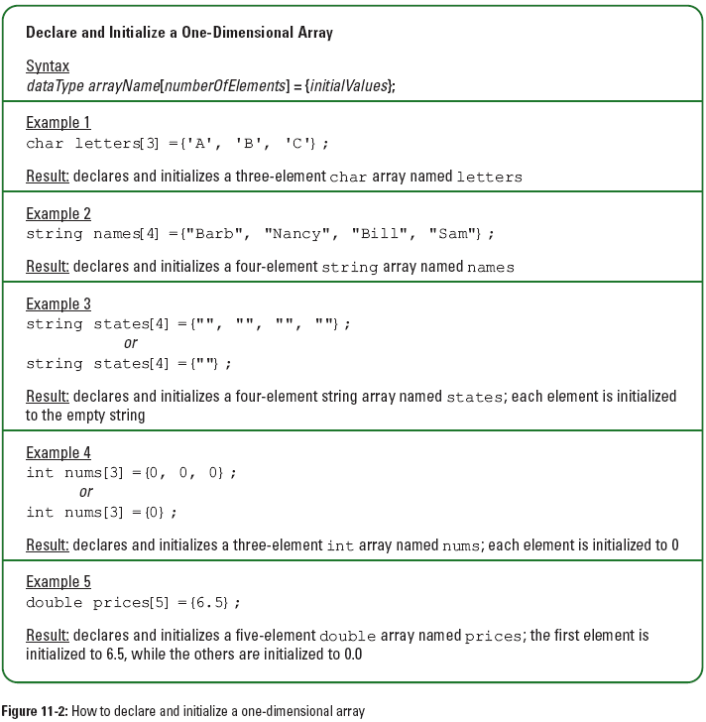
One-Dimensional Arrays (continued)

Slide 15
Linear List Operations—size()/length
determine list size
L = (a,b,c,d,e)
size = L.length;

Slide 16
Linear List Operations—get(theIndex)
get element with given index
L = (a,b,c,d,e)
get(0) = a
get(2) = c
get(4) = e
get(-1) = error
get(9) = error

Slide 17
Linear List Operations—indexOf(theElement)
determine the index of an element
L = (a,b,d,b,a)
indexOf(d) = 2
indexOf(a) = 0
indexOf(z) = -1

Slide 18
Linear List Operations—erase(theIndex)
Remove/delete element with given index
L = (a,b,c,d,e,f,g)
erase(2) removes c
and L becomes (a,b,d,e,f,g)
index of d,e,f, and g decrease by 1

Slide 19
Linear List Operations—erase(theIndex)
Remove/delete element with given index
L = (a,b,c,d,e,f,g)
remove(-1) => error
remove(20) => error

Slide 20
Linear List Operations—insert(theIndex, theElement)
add an element so that the new element has a specified index
L = (a,b,c,d,e,f,g)
insert(0,h) => L = (h,a,b,c,d,e,f,g)
index of a,b,c,d,e,f, and g increase by 1

Slide 21
Insert/Erase An Element
listSize = 5
a
b
c
d
e
insert(1,g)
listSize = 6
a
g
b
c
d
e
Notes:
To insert an element we must physically relocate elements that are to be to the right of the newly inserted element. We must also increment listSize by 1. The slide shows insert(1,g).erase(1) is the reverse.
To remove an element we must move elements to the right of the removed element left by 1 and reduce listSize by 1.

Slide 22
Linear List Operations—insert(theIndex, theElement)
L = (a,b,c,d,e,f,g)
insert(2,h) => L = (a,b,h,c,d,e,f,g)
index of c,d,e,f, and g increase by 1
add(10,h) => error
add(-6,h) => error

Slide 23
Length of Array element[]
Don’t know how many elements will be in list.
Must pick an initial length and dynamically increase as needed.
Use variable arrayLength to store current length of array element[].

Slide 24
Increasing Array Length
Length of array element[] is 6.
a
b
c
d
e
f
First create a new and larger array
T* newArray = new T[15];

Slide 25
Increasing Array Length
Now copy elements from old array to new one.
a
b
c
d
e
f
a
b
c
d
e
f
copy(element, element + 6, newArray);
Notes:
Copy() is an STL function. It copies element[0:5] to newArray[0:5].

Slide 26
Increasing Array Length
Finally, delete old array and rename new array.
delete [] element;
element = newArray;
arrayLength = 15;
element[0]
a
b
c
d
e
f

Slide 27
How Big Should The New Array Be?
At least 1 more than current array length.
Cost of increasing array length when array is full is Θ(old length).
Cost of n insert operations done on an initially empty linear list increases by Θ(n²).
Notes:
When array length is increased by 1 each time we need to resize the array element[], the cost of n add operations goes up by Theta(n²). To see this suppose we start with an empty list and element.length = 1. Each element, other than the first, that is added to the list requires an array resize to be done. When element i, i > 0 is added, the array resizing requires i steps. So the total array resizing cost is Theta(n²). If the add operations are all done at the right end, then the cost of all n adds (in the absence of array resizing) is Theta(n). The resizing time dominates the overall effort. When the additions are done at the front of the list the resizing time is of the same order as the add time.

Slide 28
Array Doubling
Double the array length.
a
b
c
d
e
f
newArray = new char[12];
a
b
c
d
e
f
Time for n inserts goes up by Q(n).

Slide 29
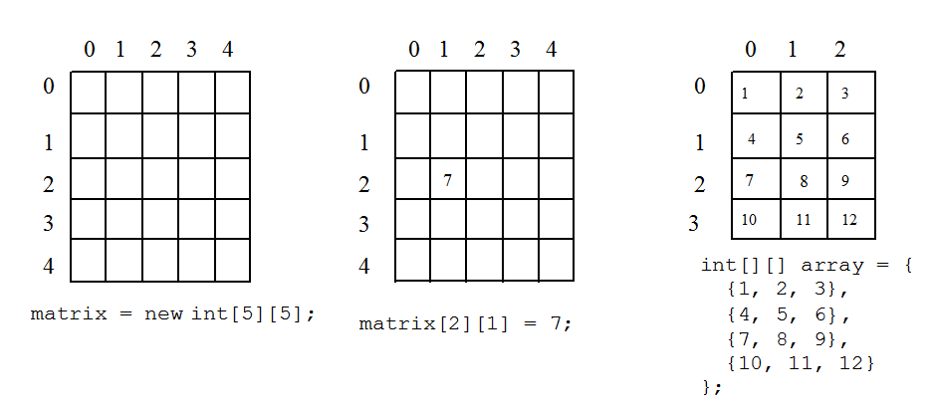
Multidimensional Array/2D Arrays
The elements of a 2-dimensional array a declared as:
int a[3][4];
may be shown as a table
a[0][0] a[0][1] a[0][2] a[0][3]
a[1][0] a[1][1] a[1][2] a[1][3]
a[2][0] a[2][1] a[2][2] a[2][3]

Slide 30
Two-Dimensional Arrays (continued)

Slide 31
Two-Dimensional Arrays (continued)

Slide 32
Rows Of A 2D Array
a[0][0] a[0][1] a[0][2] a[0][3] row 0
a[1][0] a[1][1] a[1][2] a[1][3] row 1
a[2][0] a[2][1] a[2][2] a[2][3] row 2

Slide 33
Columns Of A 2D Array
a[0][0] a[0][1] a[0][2] a[0][3]
a[1][0] a[1][1] a[1][2] a[1][3]
a[2][0] a[2][1] a[2][2] a[2][3]
column 0
column 1
column 2
column 3

Slide 34
2D Array Representation In C++
2-dimensional array x
a, b, c, d
e, f, g, h
i, j, k, l
view 2D array as a 1D array of rows
x = [row0, row1, row 2]
row 0 = [a,b, c, d]
row 1 = [e, f, g, h]
row 2 = [i, j, k, l]
and store as 4 1D arrays

Slide 35
2D Array Representation In C++
x[]
a
b
c
d
e
f
g
h
i
j
k
l
4 separate 1-dimensional arrays
x.length = 3
x[0].length = x[1].length = x[2].length = 4
Notes:
The 4 separate arrays are x, x[0], x[1], and x[2].

Slide 36
Space Overhead
x[]
a
b
c
d
e
f
g
h
i
j
k
l
space overhead = overhead for 4 1D arrays
= 4 * 8 bytes
= 32 bytes
= (number of rows + 1) x 8 bytes

Slide 37
Array Representation In C++
x[]
a
b
c
d
e
f
g
h
i
j
k
l
This representation is called the array-of-arrays representation.
Requires contiguous memory of size 3, 4, 4, and 4 for the 4 1D arrays.
1 memory block of size number of rows and number of rows blocks of size number of columns

Slide 38
Row-Major Mapping
In computing, row-major order and column-major order describe methods for storing multidimensional arrays in linear memory.
Example 3 x 4 array:
a b c d
e f g h
i j k l
Convert into 1D array y by collecting elements by rows.
Within a row elements are collected from left to right.
Rows are collected from top to bottom.
We get y[] = {a, b, c, d, e, f, g, h, i, j, k, l}
row 0
row 1
row 2
…
row i

Slide 39
Locating Element x[i][j]
0
c
2c
3c
ic
row 0
row 1
row 2
…
row i
assume x has r rows and c columns
each row has c elements
i rows to the left of row i
so ic elements to the left of x[i][0]
so x[i][j] is mapped to position
ic + j of the 1D array

Slide 40
Space Overhead
row 0
row 1
row 2
…
row i

Slide 41
Disadvantage
Need contiguous memory of size rc.

Slide 42
Column-Major Mapping
a b c d
e f g h
i j k l
Convert into 1D array y by collecting elements by columns.
Within a column elements are collected from top to bottom.
Columns are collected from left to right.
We get y = {a, e, i, b, f, j, c, g, k, d, h, l}

Slide 43
Searching Arrays, Linear/binary search
Searching is the process of looking for a specific element in an array; for example, discovering whether a certain score is included in a list of scores. Searching, like sorting, is a common task in computer programming.
There are many algorithms and data structures devoted to searching. Two commonly used approaches are, linear search and binary search.

Slide 44
Sources used
Lectures by Mr. Mohammad Asad Abbasi

